Slide 1
Improving Model Accuracy

Slide 2
What’s a Hyperparameter?
A feature you can mess with that may potentially improve accuracy
Every ML model has its own

Slide 3
Hyperparameters for DT and RF
Maximum depth
Number of estimators
Maximum number of features
Minimum number of samples for a leaf

Slide 4
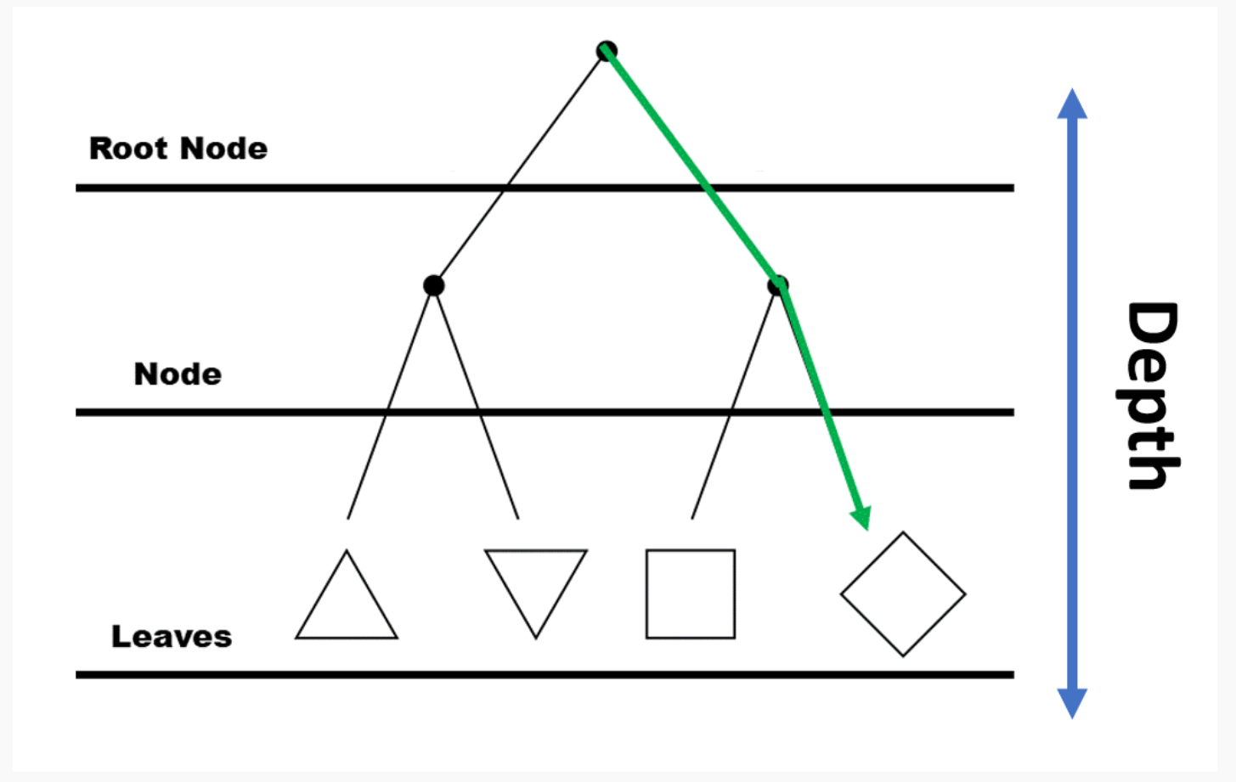
Depth
How far down the roots of your tree go
How many nodes its allowed to pass through

Slide 5
Number of Estimators (RF only)
How many trees you allow in your forest
More trees = better accuracy and more time

Slide 6
Number of Features
How many branches / decision points on the tree in total
1
2
3

Slide 7
Number of Samples
How many data points sorted at each feature
Is it useful if the decision rule only applies to one or two data points?

